Slide 1
My Year of Personal Reading (2016-17)
Mr. Jackson

Slide 2
For more description, follow me @12mrjackson.
See many student and
teacher picks at on
Twitter at #aphsreads.
I’m finishing this one
now. Graphic, but
genuine.

Slide 3
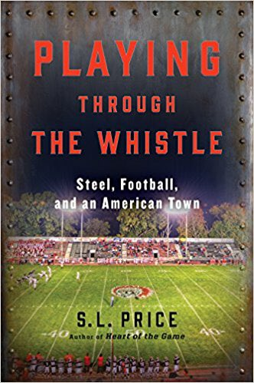
#1
One of the best all year.
Friday Night Lights
meets All the Right
Moves.

Slide 4
#2
Just as funny in print.

Slide 5
#3
Life-altering.

Slide 6
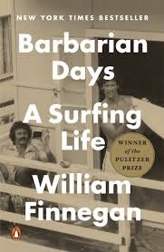
#4
Learned more about surfing
than anyone should. Great
story, though.

Slide 7
#5
How can anyone not like it?
Wow. What a visionary.

Slide 8
#7
Great change of pace for me.

Slide 9
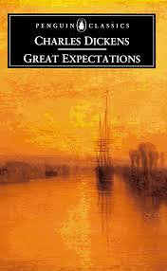
#6
Long-winded, but worth it.

Slide 10
#8
Pretty artsy. Different.

Slide 11
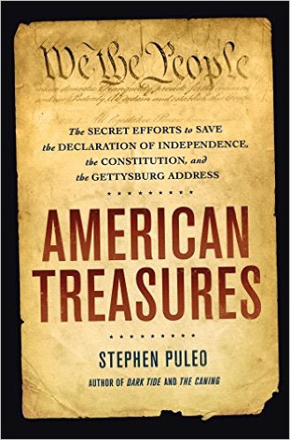
#9
Found the history of
these artifacts
fascinating.

Slide 12
#10
Hopefully not the future.
Dystopia pioneer.

Slide 13
#11
I need to read more from
Wally Lamb.

Slide 14
#12
Master of the intricate plot.

Slide 15
#13
Slightly darker dystopia.
Eerily relevant.

Slide 16
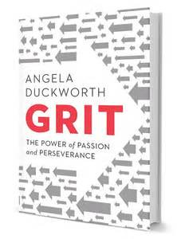
#14
Made me re-think how I
teach and parent.

Slide 17
#15
Impressive writing style.
Answered a lot of questions.

Slide 18
#16
One Book, One School for
us. Netflix series is watchable,
but diverts from the book.

Slide 19
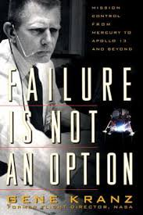
#17
Labored through this one.
Kind of technical for me.

Slide 20
#18
I appreciate this more every
time that I read it.

Slide 21
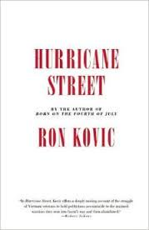
#19
Kovic is a compelling story-
teller. Behind the scenes of
Born on the Fourth of July.

Slide 22
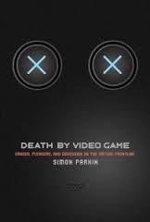
#20
Not the thesis that I expected.
Video games don’t (usually)
kill you.

Slide 23
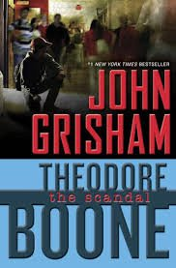
#21
Wonderful adventure for
a kid just trying to take
a standardized test.

Slide 24
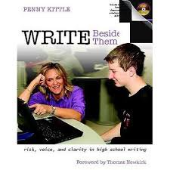
#22
I’ve adapted about 5% of
What she espouses. And
that is what she wanted.

Slide 25
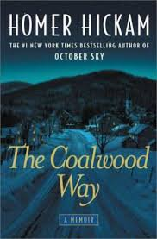
#23
Maybe even better than
Rocket Boys. A must read if
you need to know more about
Homer and Coalwood.

Slide 26
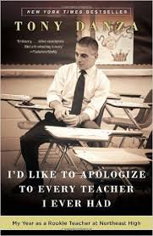
#24
Title says it all.

Slide 27
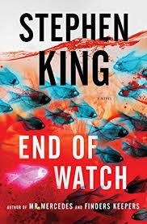
#25
Tidy conclusion to this
entertaining series by
Stephen King.

Slide 28
#26
I would recommend to
anyone. Original paperback
during WWII.

Slide 29
#27
Intriguing take on dystopian
literature.

Slide 30
#28
Who couldn’t use this at
the end of the year?

Slide 31
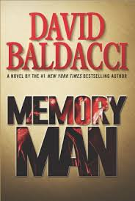
#29
Loved this. Kind of trashy,
but readable. A little
disturbing.

Slide 32
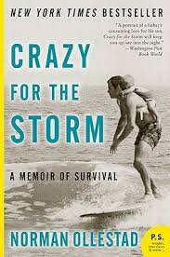
#30
Now this kid had grit. Read
to find out why

Slide 33
Epilogue
What a great journey. I was able to learn a lot, be entertained, and experience just about every emotion vicariously through these books. And I checked out most of them from the library. If you have any questions about the books, or have suggestions for me to read, please contact me @12mrjackson or jacksona@appublicschools.com. Happy reading!

